Slide 1
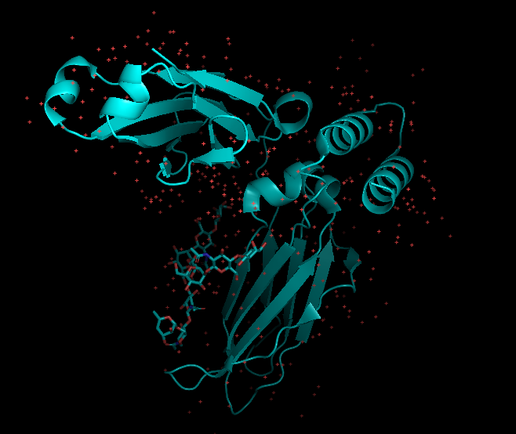
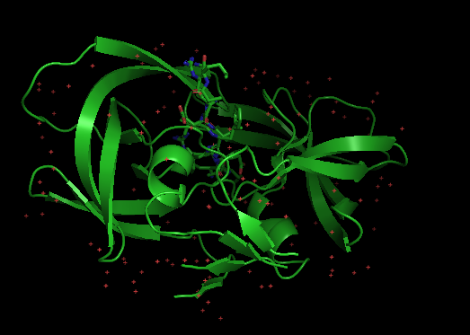
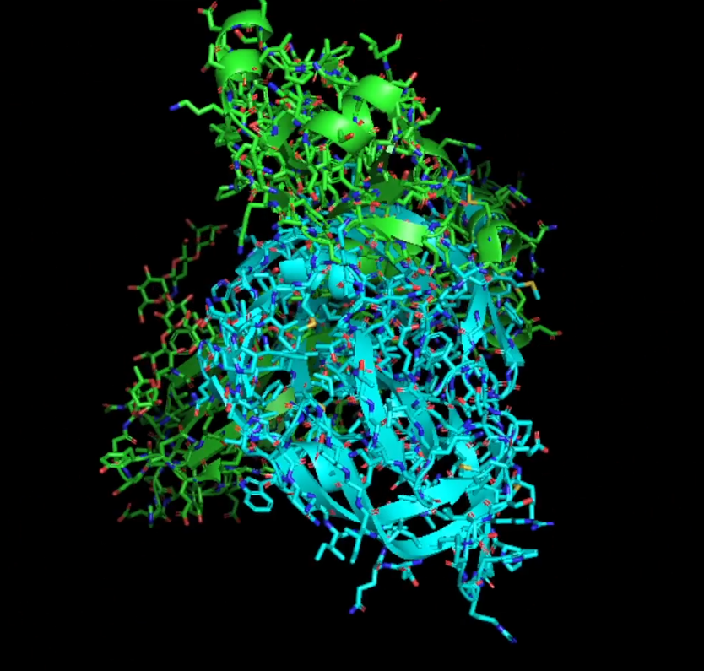

Potential Interaction Between 1L6X and 1K2B:
Given that 1L6X involves the IL-6 receptor and 1K2B involves the IL-2 receptor, these two proteins could have functional overlap in immune signaling pathways. Both IL-2 and IL-6 play important roles in immune system regulation, and their receptors are involved in T-cell activation and differentiation.
IL-6 and IL-2 can have synergistic or antagonistic effects in immune responses. For example, IL-6 promotes inflammation and the differentiation of B-cells, while IL-2 is crucial for T-cell growth and survival.
IL-6R (1L6X) and IL-2Rα (1K2B) may interact through shared immune signaling pathways or in the context of diseases where both cytokines play a role, like autoimmune disorders, cancers, or chronic inflammation.
+

Slide 2
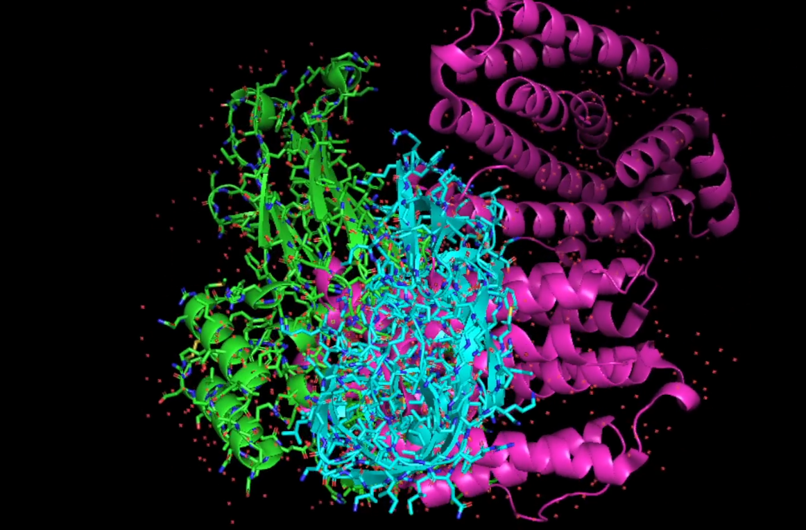
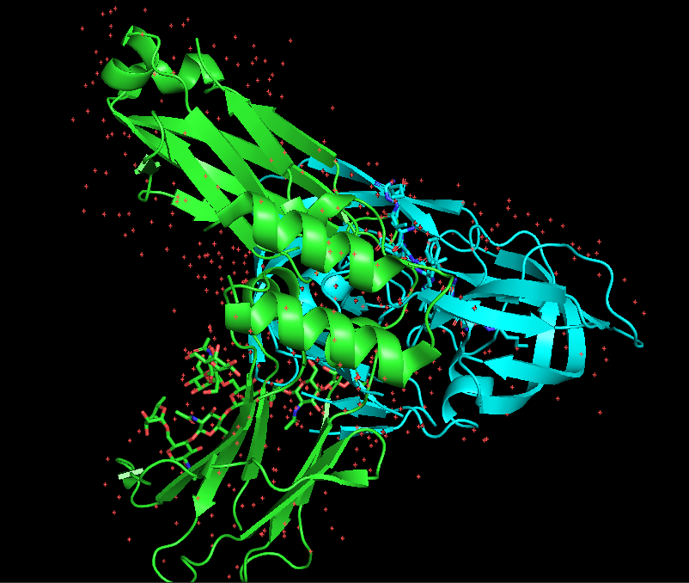
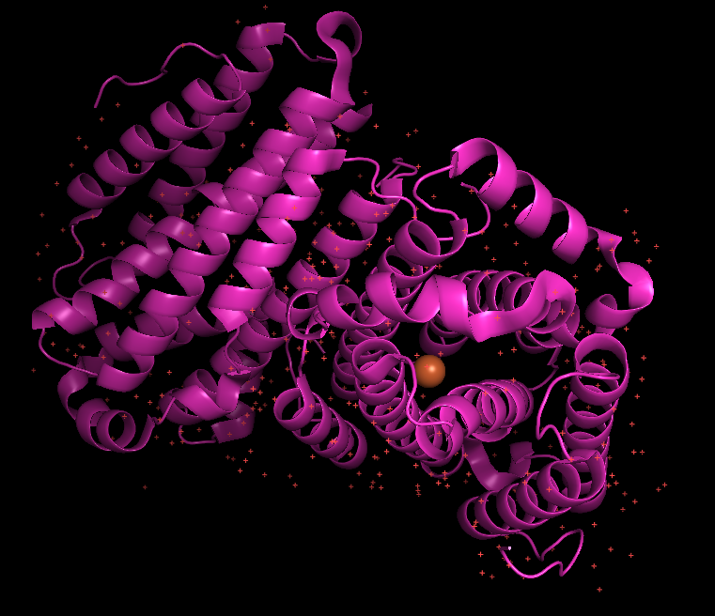
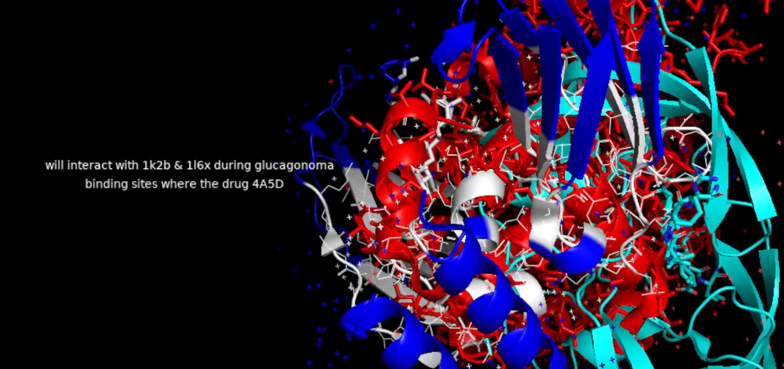
4A5D treatment for glucagonoma
The 4A5D structure itself does not treat glucagonoma, but it plays an important role in understanding how drugs, particularly those used in glucagonoma treatment, are metabolized in the body.
For drug injection, we are using Pymine library
+
1k2b + 1l6x
4a5d

